Slide 1

Avalanche Occurrence Detection using Sentinel-1 C-band SAR Data
CE-716: Data Processing in Remote Sensing - Mini Project
Submitted by:
Sudhir Dhamija (22D0312),
Manav Kumar Kawath (22M0593)

Slide 2
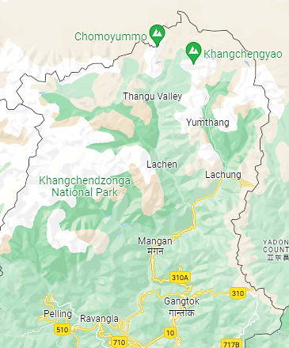

Sikkim Avalanche on 20 Jan 2020
Accident Location
(20.01.2020)
Sikkim Avalanche Location
Sentinel 2 Optical Imageries dated 15 Jan, 20 Jan, 25 Jan 2020

Slide 3
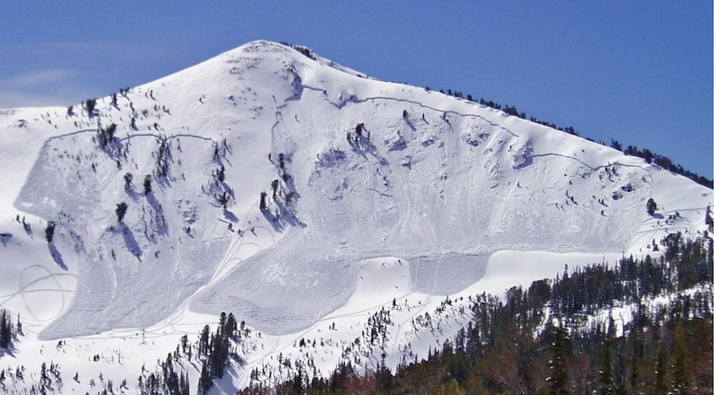
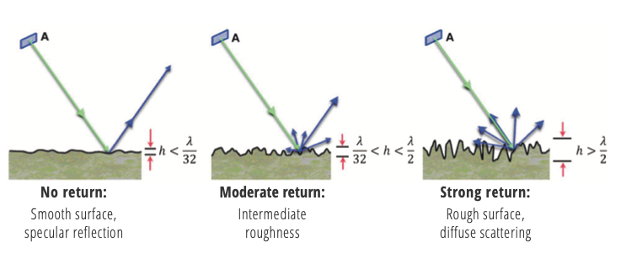
USING BACKSCATTER TO IDENTIFY AVALANCHE
Rough Surfaces give stronger returns. So avalanche debris would have stronger signals than non-avalanche sites.

Slide 4
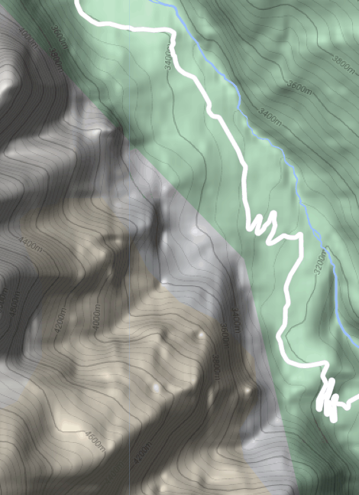
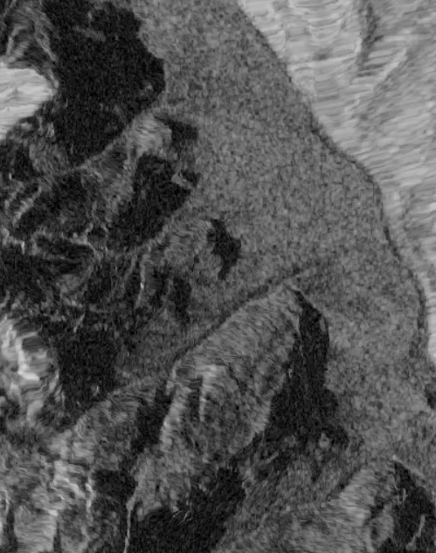
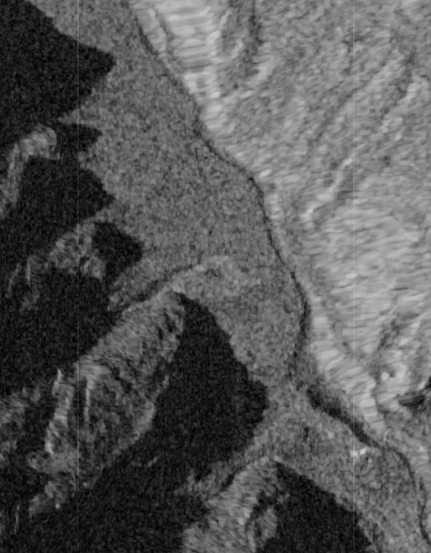
SAR BACKSCATTER from avalanche debris
Avalanche Site SAR Image – Pre Event SAR Image – Post Event

Slide 5
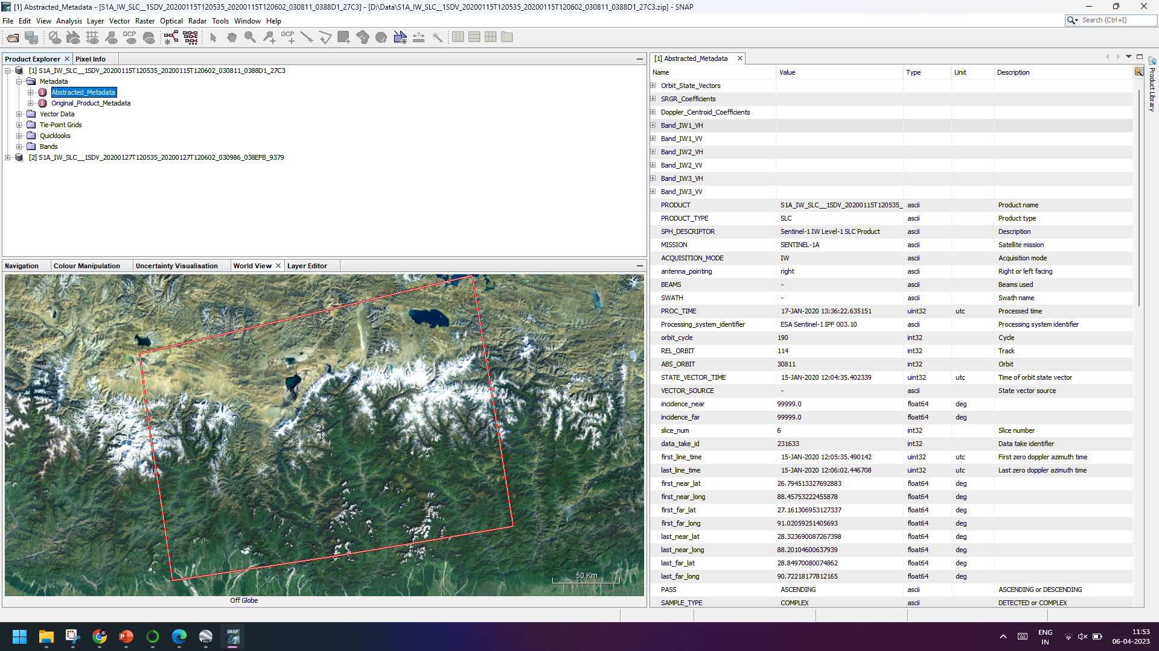
Downloading & Processing 2 SAR Images – Pre & Post Event
Product
S1A IW SLC
Pass
Ascending
Pre Image
15 Jan 2020
Post Image
27 Jan 2020
Initial Processing
SNAP

Slide 6
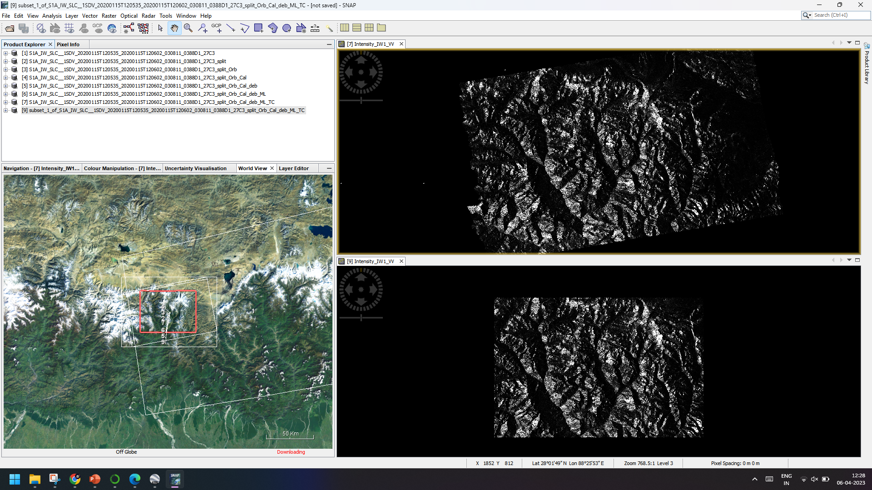
Steps
Read in data
S1 TOPS Split
Apply precise orbit files
Radiometric calibration
S1 TOPS Deburst
Multilooking
Geocoding/ Geometric terrain correction
Subset

Slide 7
Further Processing
Using Python in the Jupyter Notebook environment

Slide 8
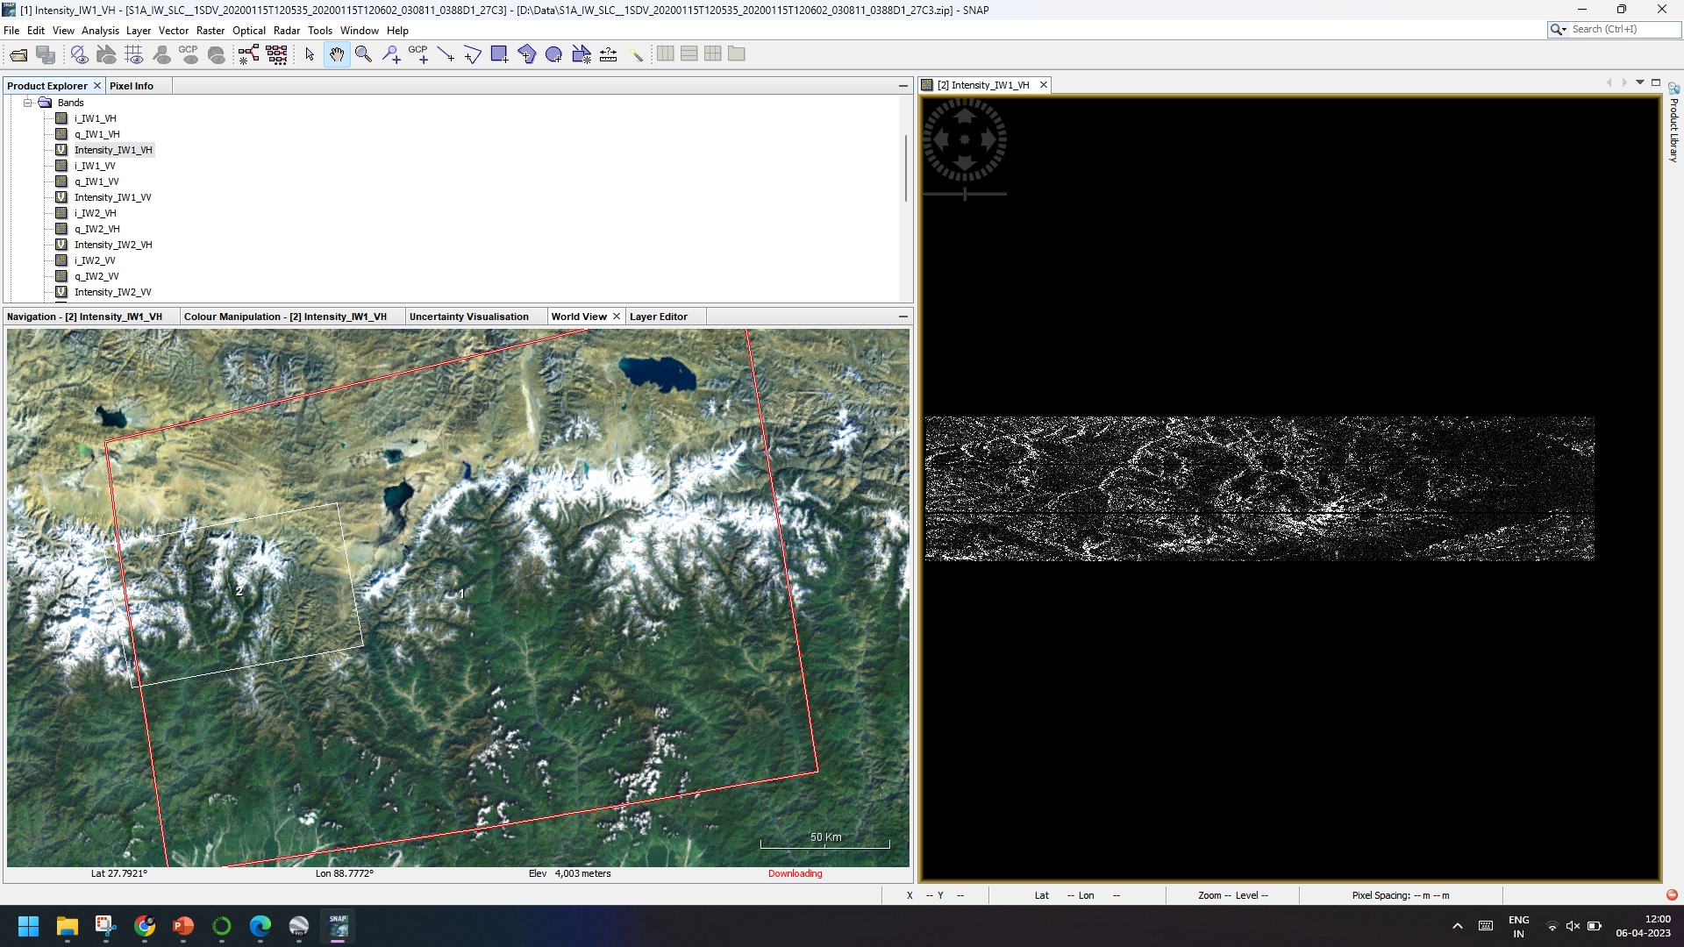
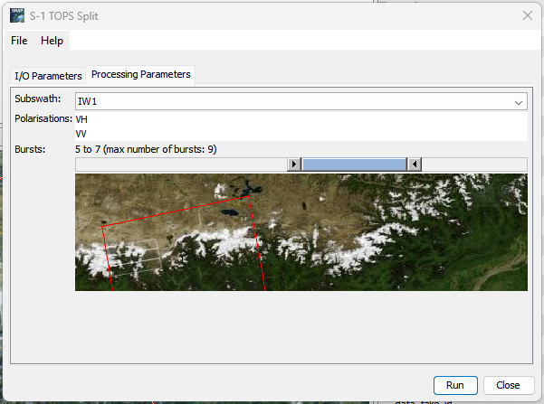
S1 Tops split
Radar → Sentinel-1 TOPS → S-1 TOPS Split

Slide 9
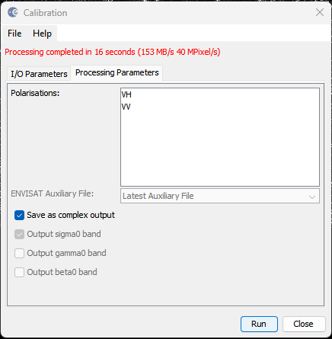
Radiometric calibration
Radar → Radiometric → Calibrate
Save as complex output

Slide 10
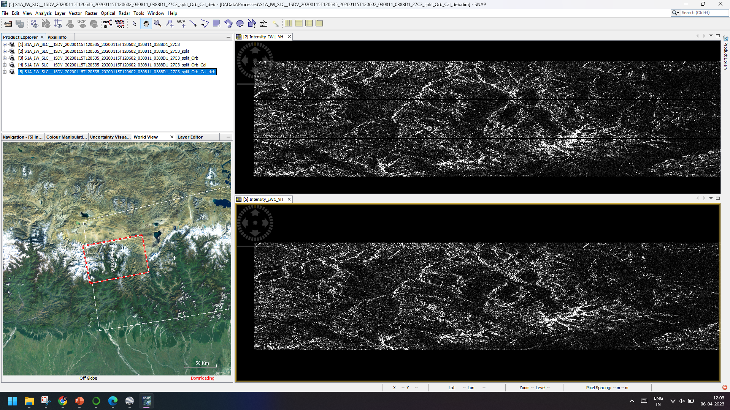
S1 TOPS De-burst
Radar → Sentinel-1 TOPS → S-1 TOPS De-burst

Slide 11
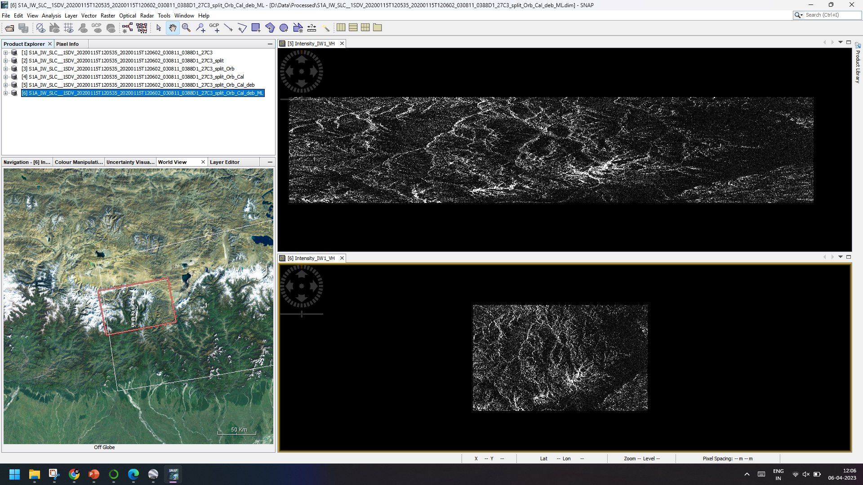
Multi-looking
3x1 Multi-Look

Slide 12
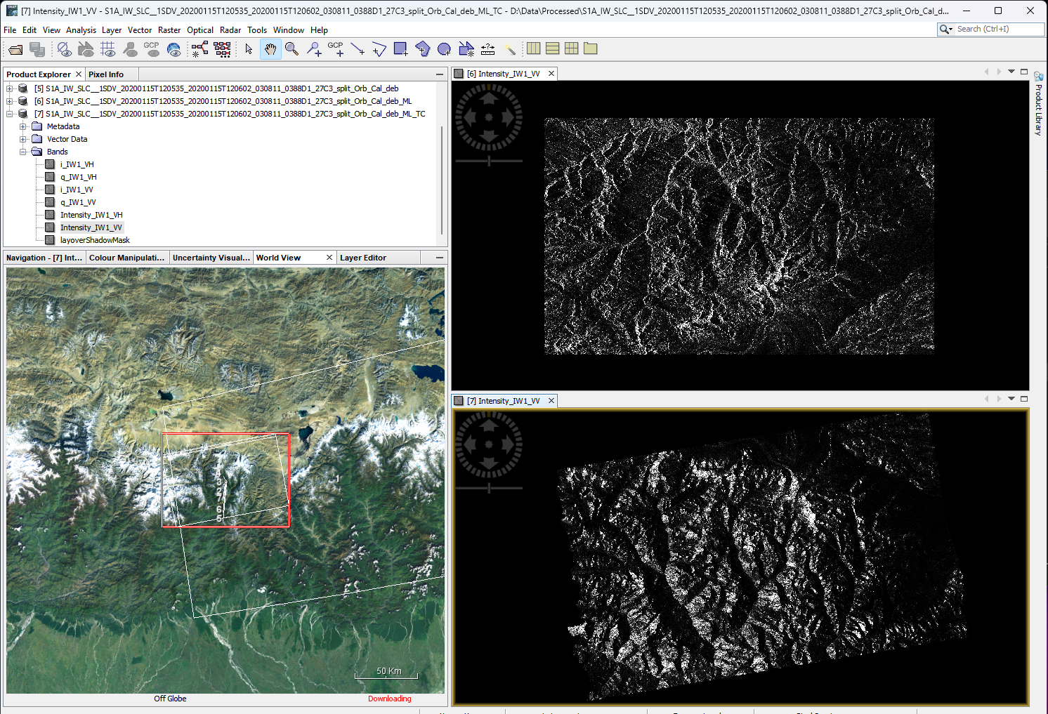
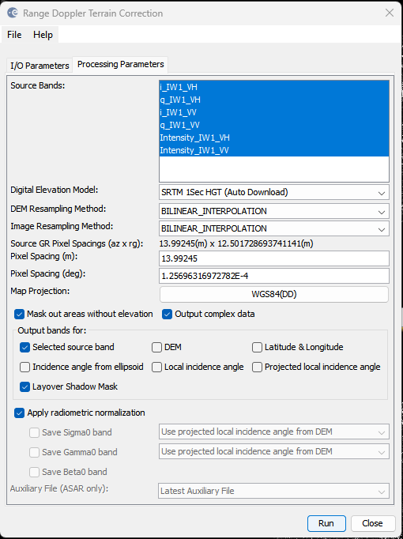
Geometric Terrain Correction
Radar → Geometric → Terrain Correction → Range-Doppler Terrain Correction
Save Complex Output

Slide 13
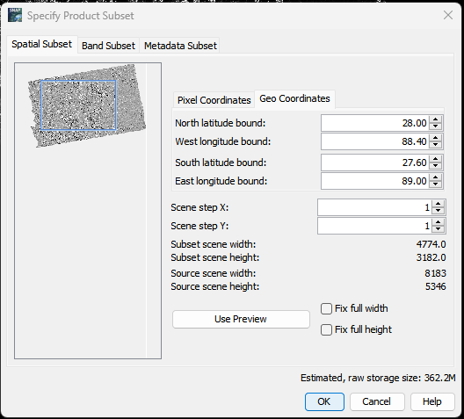
Subset for final processing
Create equal subsets of both images

